Slide 1





3D INTERACTIVE MAP
Kolhapur Institute Of Technology, Kolhapur

Slide 2

OUR TEAM
Anusha Patil B44
Pratik Patil B46
Adarsh Gurav B73
Sanket Magdum B77

Slide 3
ABSTRACT
This project presents a 3D interactive map of Kolhapur District that provides information about Historical and Tourism places in different languages with audio support.
The objective is to improve accessibility and enhance tourism experiences. The system integrates Mapping APIs, Multi-Language text-to-speech technologies, and user-friendly interfaces.

Slide 4
INTRODUCTION
Background : Tourism and cultural heritage of Kolhapur. Which will increase the interaction between the people, also helps to find out the information easily.
Motivation : Promote tourism and ensure accessibility for all. Tourism is one of the important factor in day to day life. There are many cases in which people get wrong information. To avoid these things and for proper guidance this website or project is really usefull.

Slide 5
PROBLEM STATEMENT
From Smart India Hackthon:-
Development of a Smart Digital Platform to Promote Eco & Cultural Tourism in Jharkhand.
ID : SIH25032
Sector : Travel and Tourism

Slide 6
LITERATURE REVIEW
  Early web maps were 2D; advancement of WebGL enabled real-time 3D visualization.
  Platforms like Mapbox GL JS and CesiumJS provide interactive 3D mapping in browsers.
  CityGML / CityJSON are widely used standards for representing semantic 3D city models.
  Literature stresses combining semantic models + streamable formats + efficient rendering for effective 3D maps.

Slide 7
METHODOLOGY
  Research Approach:
Studied existing 3D map frameworks and user needs (multilingual, audio support).
Designed and built a prototype focused on Kolhapur city.
For More attraction made a blender animation earth with zoom effects.
  Tools and Technologies:
Mapbox GL JS – for 3D map rendering.
HTML, CSS, JavaScript (react)– for web development.
Audio libraries – to provide multilingual audio support.
Blender – For Earth animation and effects.

Slide 8
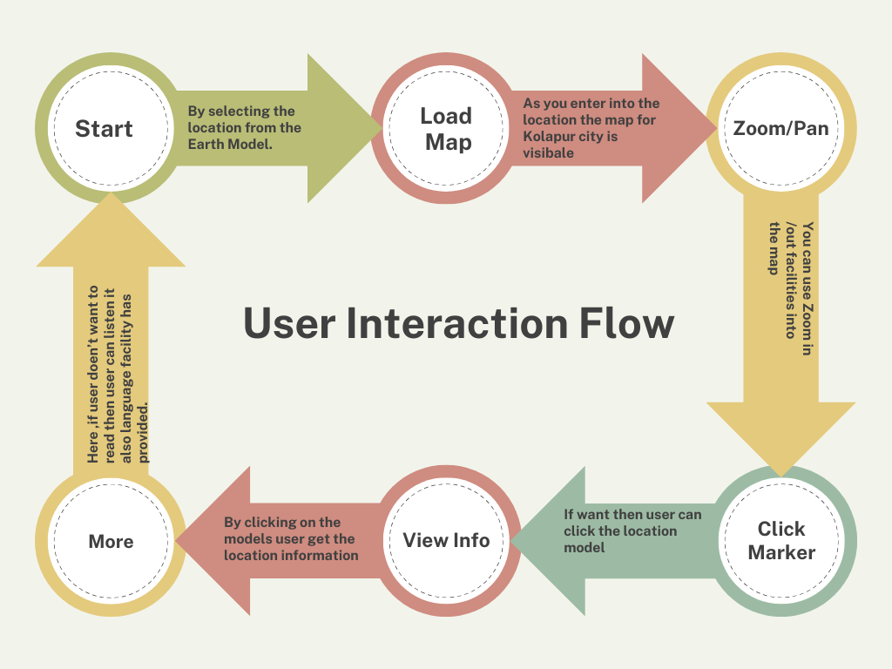
  System Architecture:
  It defines the how the user can use the website properly.
  Which includes user interaction flow ,data flow.

Slide 9
RESULT AND ANALYSIS
After completion of this project user can locates the locations easily and quickly.
Compare to traditional 2D Map, the 3D view provides in depth perception and realism of locations.
Smooth Transitions and Animations makes the map more engaging.
Due to background audio content and switching of languages gets user attractions.

Slide 10
CONCLUSION
• Project successfully delivers an accessible, multi language, and interactive tourism solution.
• It will help to get interconnected with the different locations of the kolhapur.
• It will help to understand the history of locations and due to 3D interface it increases deep understanding of users.

Slide 11
THANK
YOU

